Slide 1
Java BufferedInputStream class
The BufferedInputStream class provides buffering to your input streams. Buffering can speed up IO quite a bit. Rather than read one byte at a time from the network or disk.
The BufferedInputStream reads a larger block at a time into an internal buffer. When you read a byte from the BufferedInputStream you are therefore reading it from its internal buffer. When the buffer is fully read, the BufferedInputStream reads another larger block of data into the buffer. This is typically much faster than reading a single byte at a time from an InputStream, especially for disk access and larger data amounts.
A BufferedInputStream adds functionality to another input stream-namely, the ability to buffer the input and to support the mark and reset methods. When the BufferedInputStream is created, an internal buffer array is created. As bytes from the stream are read or skipped, the internal buffer is refilled as necessary from the contained input stream, many bytes at a time. The mark operation remembers a point in the input stream and the reset operation causes all the bytes read since the most recent mark operation to be reread before new bytes are taken from the contained input stream.
Java BufferedInputStream class is used to read information from stream. It internally uses buffer mechanism to make the performance fast.
FileInputStream
Buffer
BufferedInputStream
uses
myinputfile.txt
Java Application
Read
Read
Peter is going to India

Slide 2
Java BufferedInputStream class
To add buffering to an InputStream simply wrap it in a BufferedInputStream.
As you can see, using a BufferedInputStream to add buffering to a non-buffered InputStream is pretty easy. The BufferedInputStream creates a byte array internally, and attempts to fill the array by calling the InputStream.read(byte[]) methods on the underlying InputStream.
InputStream input = new BufferedInputStream( new FileInputStream("c:\\data\\myinputfile.txt"));

Slide 3
Java BufferedInputStream class
You can set the buffer size to use internally by the BufferedInputStream. You provide the buffer size as a parameter to the BufferedInputStream constructor, like this.
This example sets the internal buffer used by the BufferedInputStream to 8 KB. It is best to use buffer sizes that are multiples of 1024 bytes. That works best with most built-in buffering in hard disks etc.
Except for adding buffering to your input streams, BufferedInputStream behaves exactly like an InputStream.
int bufferSize = 8 * 1024;
InputStream input = new BufferedInputStream( new FileInputStream("c:\\data\\myinputfile.txt", bufferSize );

Slide 4
Java BufferedInputStream class
InputStream
FilterInputStream
BufferedInputStream

Slide 5
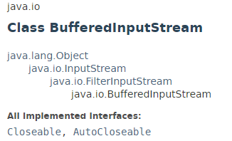
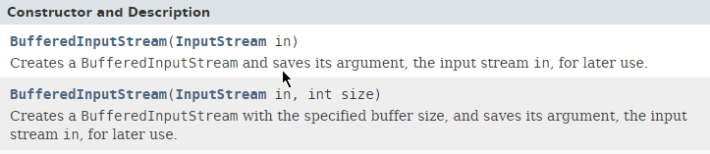
Java BufferedInputStream class

Slide 6
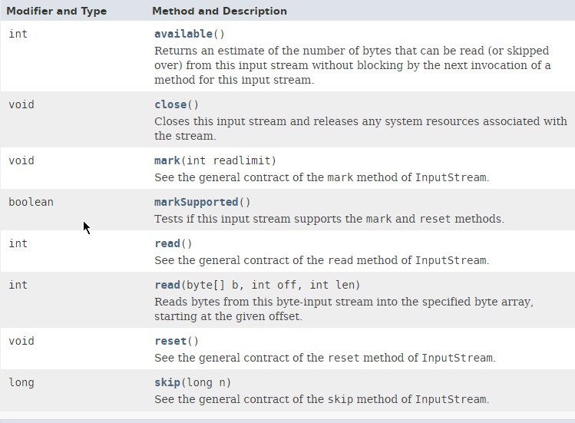
Java BufferedInputStream class

Slide 7
Java BufferedInputStream class
https://docs.oracle.com/javase/8/docs/api/index.html?java/io/BufferedInputStream.html

